Slide 1

Software Engineering
Software Project Management, Architecture & Design
Software Project Management
Department of Computer Science and Engineering
Acknowledgement: Dr. Phalachandra HL, Prof. Anand MS, authors of the prescribed textbooks and materials sourced online.

Slide 2

Risk Management
List of Contents
Risk Management
Categories of Software Risks
Principles of Risk Management
Steps in Risk Management
RMMM
Structure of RMMM Plan
Benefits
Department of Computer Science and Engineering

Slide 3
Risk Management
A risk is anything that could potentially impact your project’s timeline, performance or budget.
Risk management is the process of identifying, analyzing and responding to any risk that arises over the life cycle of a project to help the project remain on track and meet its goal
1. Reactive Risk Strategies
Dealing with risks as they occur, often in a crisis management mode.
2. Proactive Risk Strategies
Identifying and managing risks before they become problems, including developing contingency plans.

Slide 4
Categories of Software Risks
Project Risks: Risks that threaten the project plan, potentially leading to schedule delays and cost increases.
Technical Risks: Risks that threaten the quality and timeliness of the software, such as design or implementation issues.
Business Risks: Risks that threaten the viability of the software, including market risks, strategic risks, and management risks.

Slide 5
Principles of Risk Management
Maintain a global perspective: View software risks within the broader context of the system and business problem.
Take a forward-looking view: Anticipate future risks and establish contingency plans.
Encourage open communication : Encourage stakeholders to suggest risks at any time.
Integration: Incorporate risk considerations into the software process.
Emphasize a continuous process: Continuously monitor and modify risks as the project progresses.
Develop a shared product vision: Align all stakeholders with a common vision to improve risk identification and assessment.
Encourage teamwork: Pool the talents, skills, and knowledge of all stakeholders during risk management activities.

Slide 6
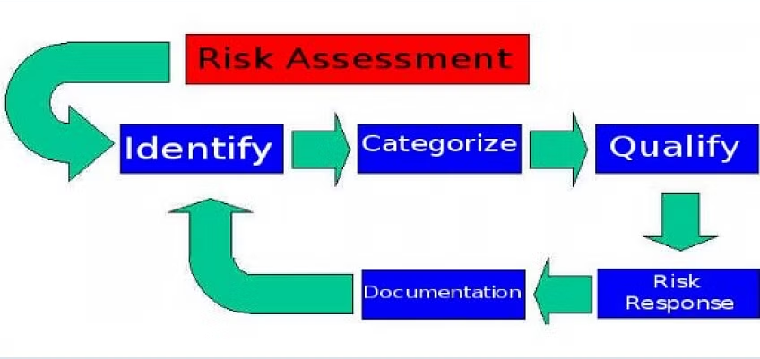
Steps in Risk Management

Slide 7
Risk Mitigation, Monitoring, and Management
Risk Mitigation, Monitoring, and Management (RMMM) is a systematic approach to handle risks throughout the lifecycle of a software project. It ensures that risks are identified, addressed, and managed to minimize their impact on the project.
Risk Mitigation
Risk Monitoring
Risk Management
Taking steps to reduce the likelihood of a risk occurring or minimizing its impact if it does occur.
Keeping track of identified risks, reassessing their impact and likelihood, and identifying new risks as the project progresses.
Process of making decisions about how to address risks, including choosing and implementing appropriate responses.

Slide 8
Structure of an RMMM Plan
Risk Identification: Listing all identified risks with their descriptions.
Risk Analysis: Assessing the probability and impact of each risk.
Risk Prioritization: Ranking risks based on their severity and likelihood.
Mitigation Strategies: Documenting the actions that will be taken to mitigate each risk.
Monitoring Plan: Outlining how each risk will be monitored throughout the project.
Contingency Plans: Developing specific plans for how to handle risks if they occur.
Ownership: Assigning responsibility for managing each risk to specific team members.

Slide 9
Benefits of RMMM
Proactive Risk Management: By anticipating and planning for risks, projects can avoid crises and manage issues before they become critical.
Increased Project Success: Effective RMMM reduces the likelihood of project delays, budget overruns, and quality issues.
Enhanced Decision-Making: Having a structured approach to risk allows project managers to make informed decisions that balance risk with opportunity.
Better Stakeholder Communication: A clear RMMM plan helps keep stakeholders informed about potential risks and how they are being managed, building confidence in the project’s success.

Slide 10
THANK YOU
Software Project Management
Department of Computer Science and Engineering
‹#›

